Slide 1
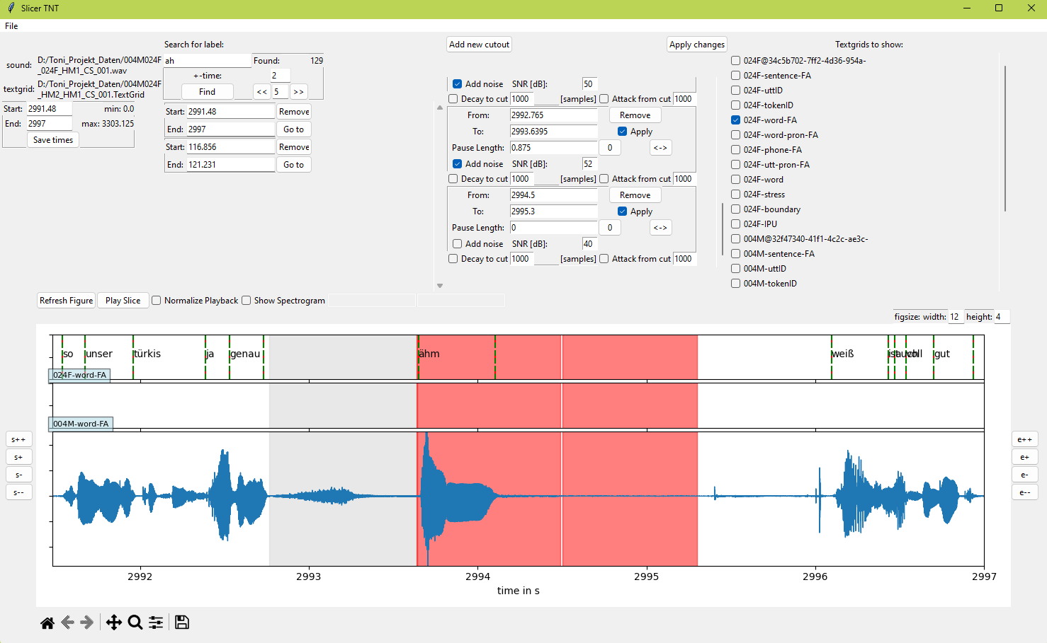
1
3
4
5
2
6
9
7
8

Slide 2
Slicer TNT - Functionality
File Menu:
load sound/textgrid files
save/load project (workspace)
export slices
Time Frame
look at specified time frame
save/remove time frames to look at later
Label Search
look for words/utterances in current active tiers
amount given, can jump to label and show +- time in seconds

Slide 3
Slicer TNT - Functionality
4. Add Cut Outs
specify frames which not to include in the exporting files (sound and textgrid)
can either be filled with silence or noise or cut out to a desired length
cut out in red in figure, pause (noise or silence) in grey
5. Select Tiers to Show
6. Refresh Figure and Play Sound
sound can be normalized to max amplitude of time frame
spectrogram can be shown
7. Add/Remove Time from Frame Start/End
8. Navigation Toolbar for Figure
9. Figure Size

Slide 4
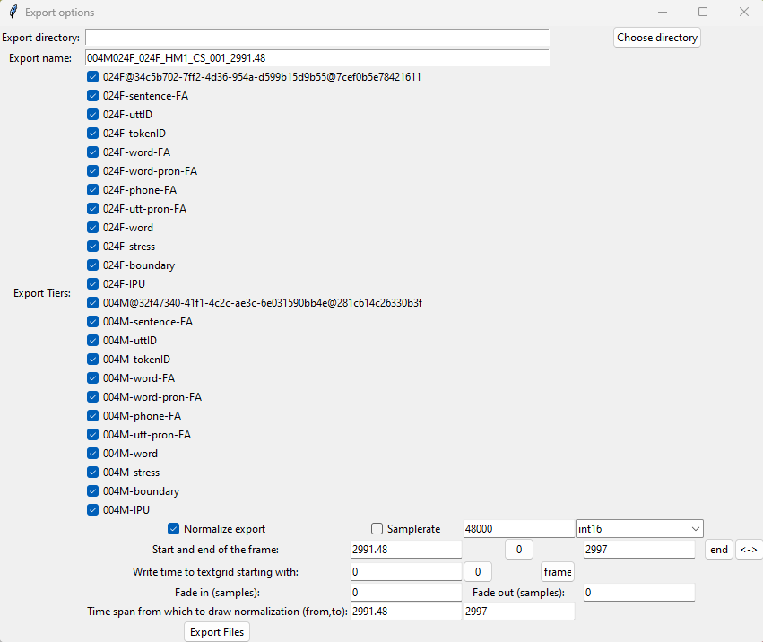
Export window
specify name and directory
select tiers which to export
sound parameters like sample rate, fade in/out and data type
textgrid parameters like starting time of tiers

